Slide 1
A new model of evaluating concept similarity

Slide 2
Introduction
FCA techniques are revealing interesting in supporting difficult activities that are becoming fundamental in the development of the semantic web.
The basic operators in rough set theory are approximation operations.

Slide 3
Introduction
A new measure model based on rough set is proposed, which preserve more structual and featual information of concept lattice.
The advantage of the proposed model consists in the measure is convenient to be calculated from objects and attributes classes sets, especially for the large context.

Slide 4
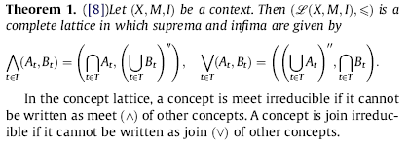
FCA and Rough Set
Basic definitions

Slide 5
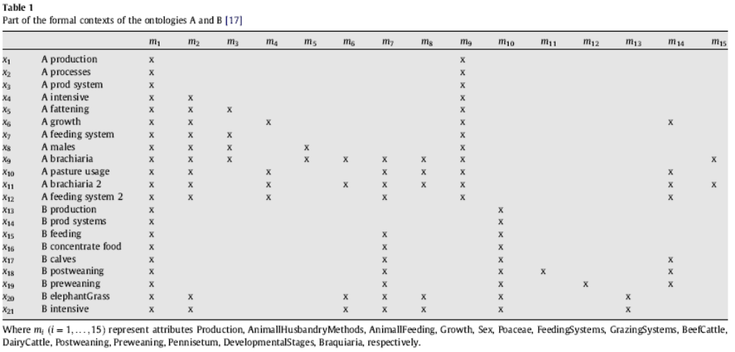

Slide 6
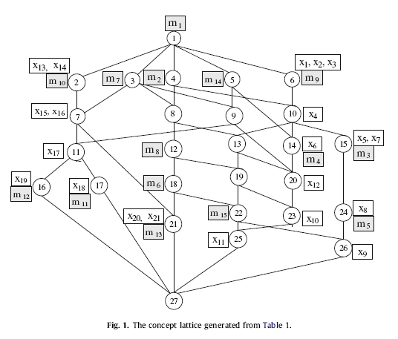

Slide 7
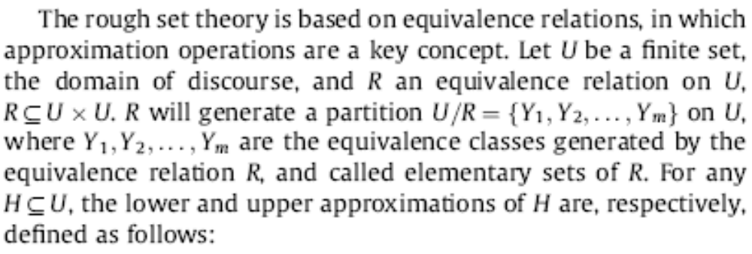

Slide 8
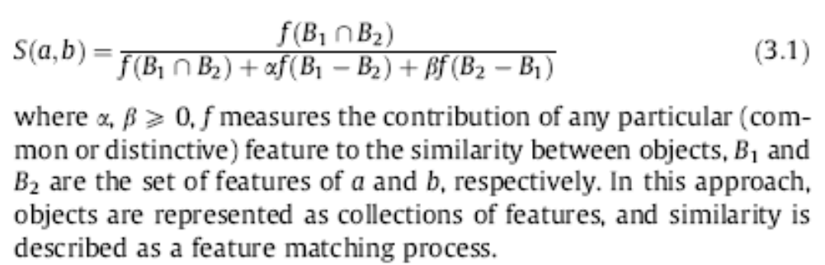
Related works of Tversky’s model

Slide 9
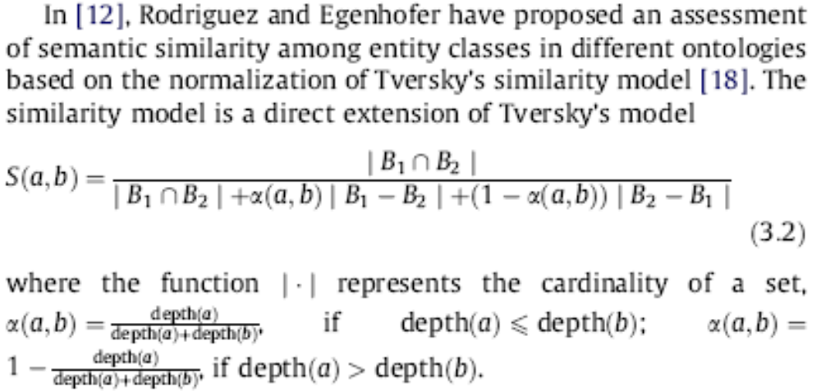

Slide 10
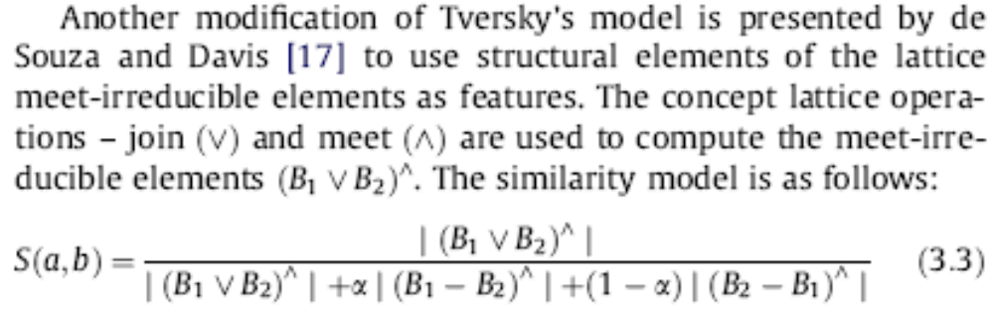

Slide 11
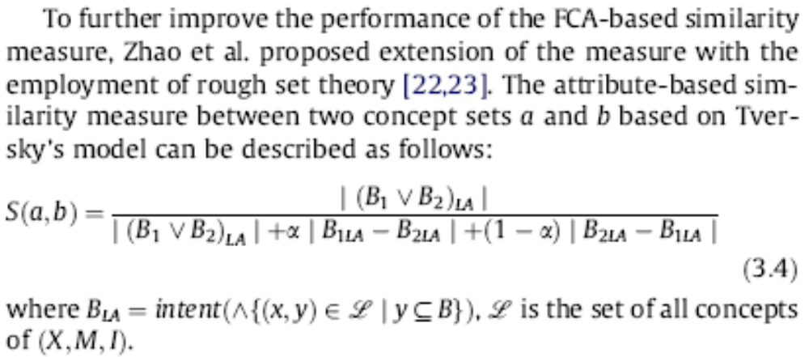

Slide 12
Similarity measure based on rough set
Evaluate the similarity of concepts of concept lattice, in which both meet irreducible elements and join irreducible are considered.
Moreover, we give an effective method to calculate this similarity measure by using objects classes and attributes classes.

Slide 13
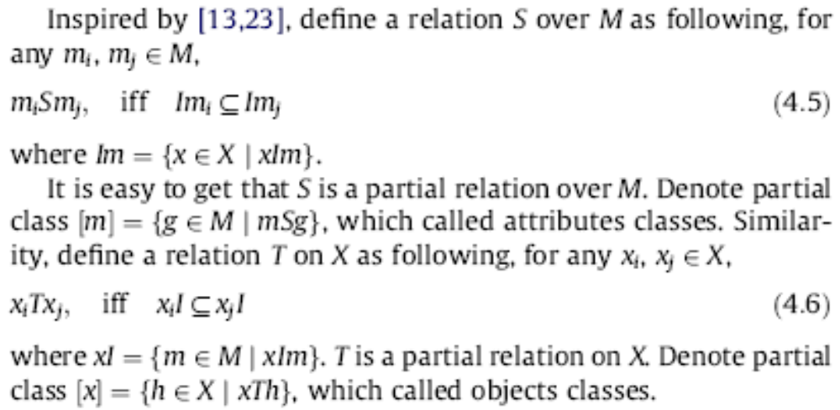

Slide 14
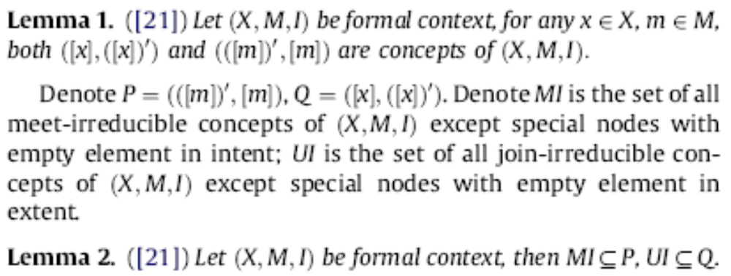
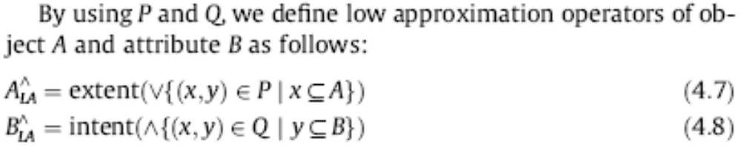

Slide 15
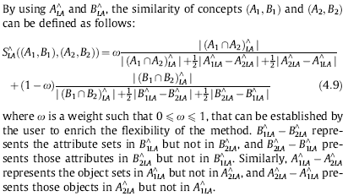

Slide 16
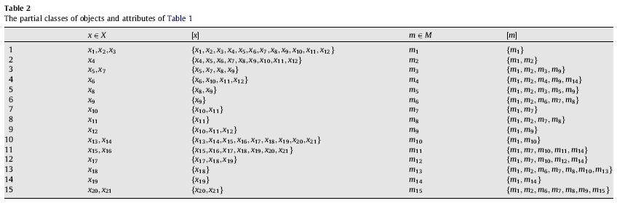

Slide 17
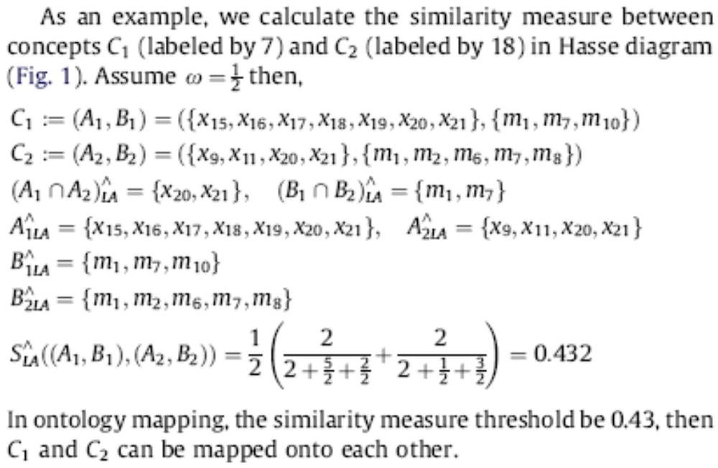

Slide 18
Conclusion
In this paper, we introduce a new similarity measure based on rough set theory, which is a development of Tversky’s similarity model. In the proposed method, we use an important fact that objects classes and attributes classes contain all meet-irreducible elements and join-irreducible elements, respectively.
The method is both featural and structural, and is easy to understand. The similarity of two concepts can be directly calculated from objects and attributes classes and is more conveniently to calculate the concepts similarity of the large context.

Slide 19
Thank you!

